Slide 1
STATIONARY STORE MANAGEMENT SYSTEM
Project by : ABDUL MUTHALIB K T
Register number:1826J0827
Guided by :
Mr. M .NANDAKUMAR M.sc,
Assistant Professor, Department of Computer Applications,
AJK College of Arts & Science,
Coimbatore-641105

Slide 2
INTRODUCTION
•
Stationary Store Management is a software application that is designed for the stores that deals in stationeries and other such shops. This system further helps in the maintenance and billing of stocks.
•
This software will make the process manually and also helps to maintain the records that are related to this subject including the handling of cash flows and stocks.
•
This system maintain the account details and sales record is the main aim of this project.The software Stationary Store Management is used for stationery purposes and it helps to maintain the regular transaction records on the desktop.

Slide 3
SYNOPSIS
Currently the transactions in the stationary stores are maintained as per the manual system and on the daily system. In order to improve the work efficiency like that of tracking the sales and other related issues some more advanced system is required. The new proposed system help people in several ways like it help them in processing the billing easily. Maintaining the accounts will also become easier. It can help to keep a track of the sale and the details of the accounts. The software comes with the master entries that enable to enter new products or customer entry to modify, delete and add.
The frontend of the project is PYTHON3 tkinter module is used and backend is SQL LITE. WINDOWS 10 is used as operating system
The STOCK is the main module of this system here admin manages the stationaries available in the shop. ORDER module shop by the users is stored in this entity and as the no of items and category of the item the order will be passed and items provided will be given to him . LOGIN module helps user to login using username and password .once the credentials are validated, user can be given privileged access

Slide 4
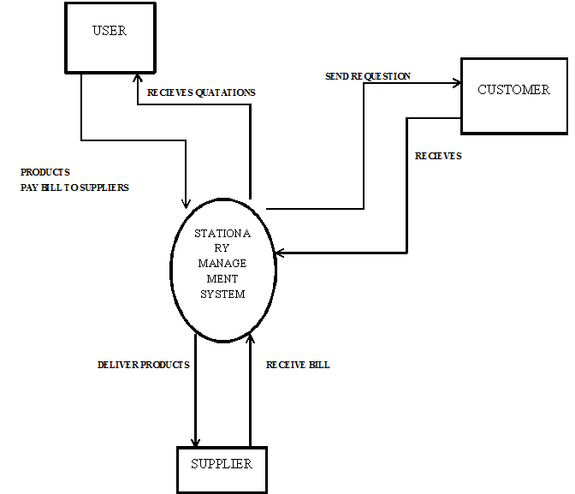
DATA FLOW DIAGRAM
Level 0

Slide 5
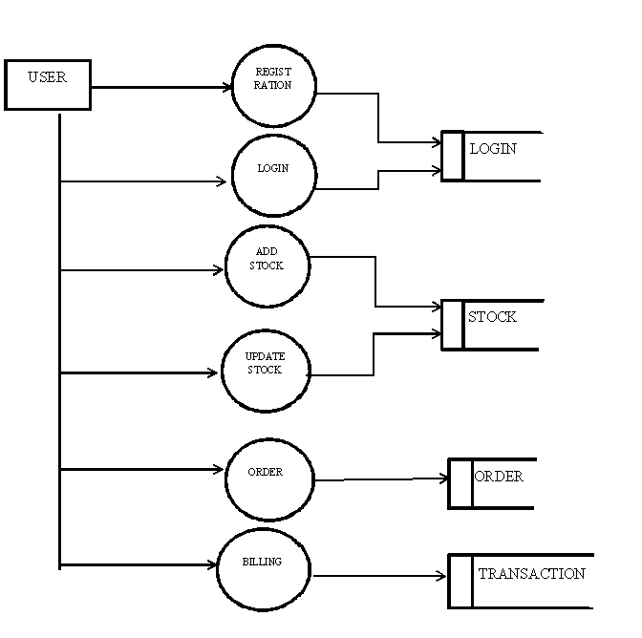
Level 1

Slide 6
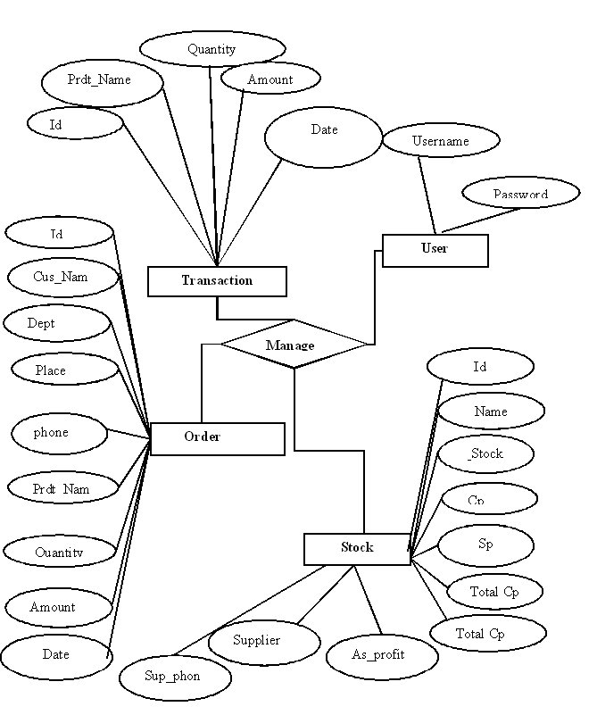
ER DIAGRAM

Slide 7
TABLE DESIGN
Table Name: Login
Field Name | Data Type | Size | Description
User_Name | TEXT | 20 | It represents User name
Password | TEXT | 20 | It represents Password

Slide 8
Table Name: Stock
Field Name | Data Type | Size | Description
Id | INTEGER | 20 | Identify stock with Id
Name | TEXT | 20 | It represents stock Name
stock | NUMERIC | 10 | It represents stock Quantity
Cp | INTEGER | 10 | It represent Cost Price
Sp | INTEGER | 20 | It represents selling price
TotalCp | INTEGER | 30 | It represent Total cost price
TotalSp | INTEGER | 30 | It represents Selling Price
Assumed_Profit | INTEGER | 50 | It represent Assumed profit
Vendor | TEXT | 20 | Store vendor name
Vendor_phone | INTEGER | 20 | Store vendor phone no

Slide 9
Table Name : Transaction
Field Name | Data Type | Size | Description
Id | INTEGER | 20 | Identify Represent Id
Product_Name | TEXT | 20 | It represents stock Name
Quantity | INTEGER | 10 | It represents stock Quantity
Amount | INTEGER | 10 | It represent item price
Date | TEXT | 10 | It represent Date of Transaction

Slide 10
Table Name: Order
Field Name | Data Type | Size | Description
Id | INTEGER | 20 | Identify Represent Id
Customer_Name | TEXT | 20 | Represent buyer Name
Place | TEXT | 20 | Represent buyer Place
Phone | INTEGER | 20 | Identify Represent Phone
Product_Name | TEXT | 20 | It represents stock Name
Quantity | INTEGER | 10 | It represents stock Quantity
Amount | INTEGER | 10 | It represent item price
Date | TEXT | 10 | It represent Date of Transaction

Slide 11
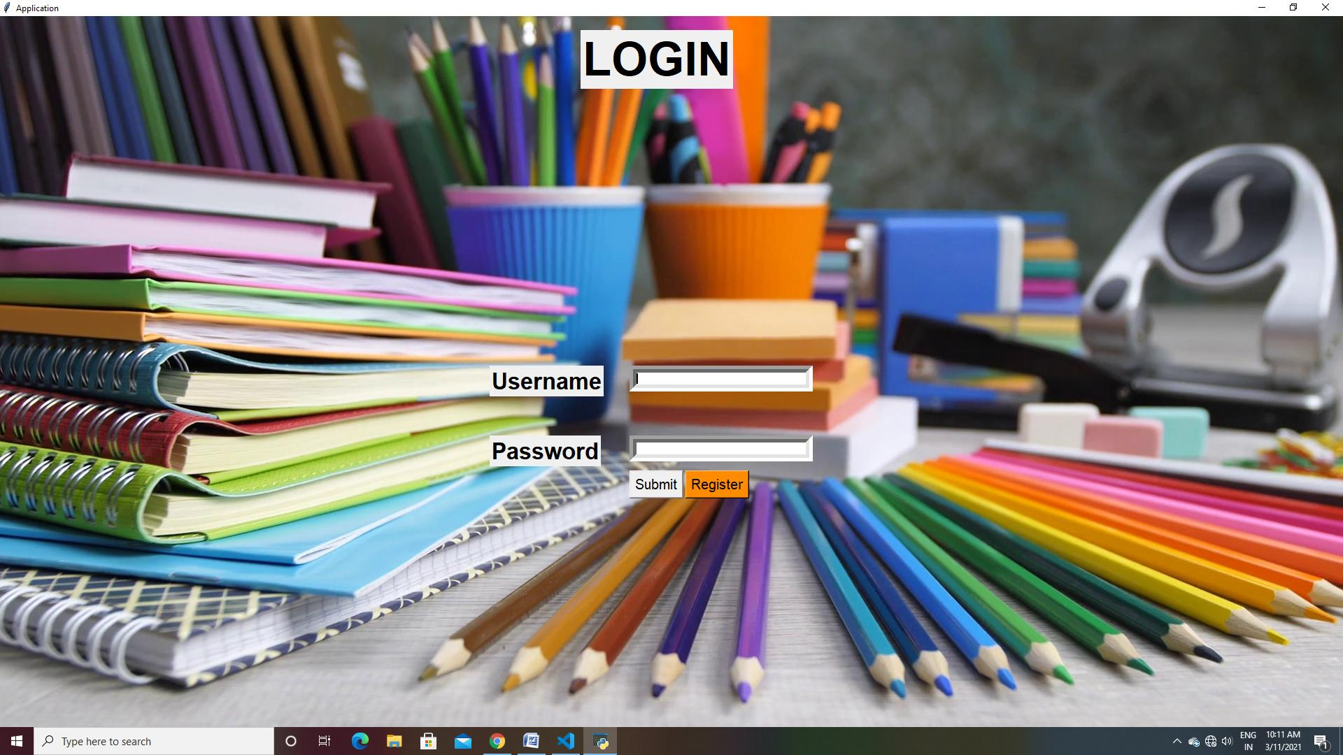
FORM DESIGN

Slide 12
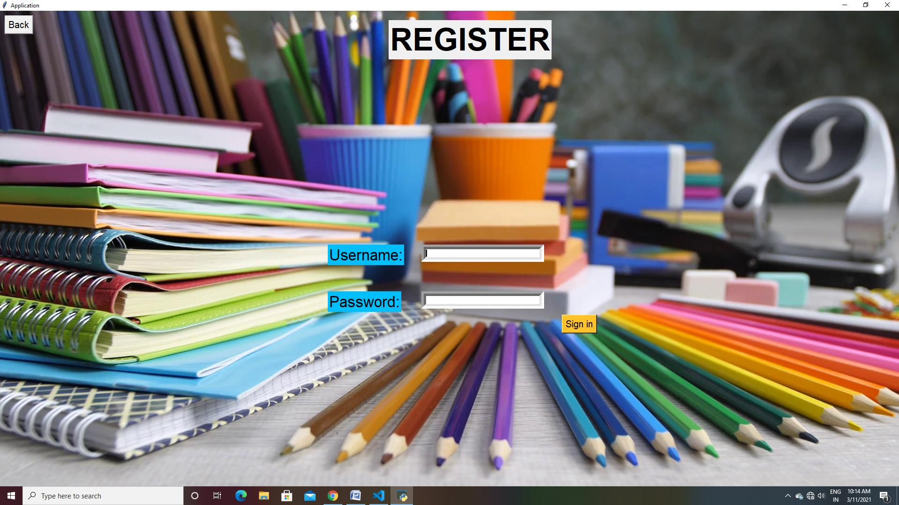

Slide 13
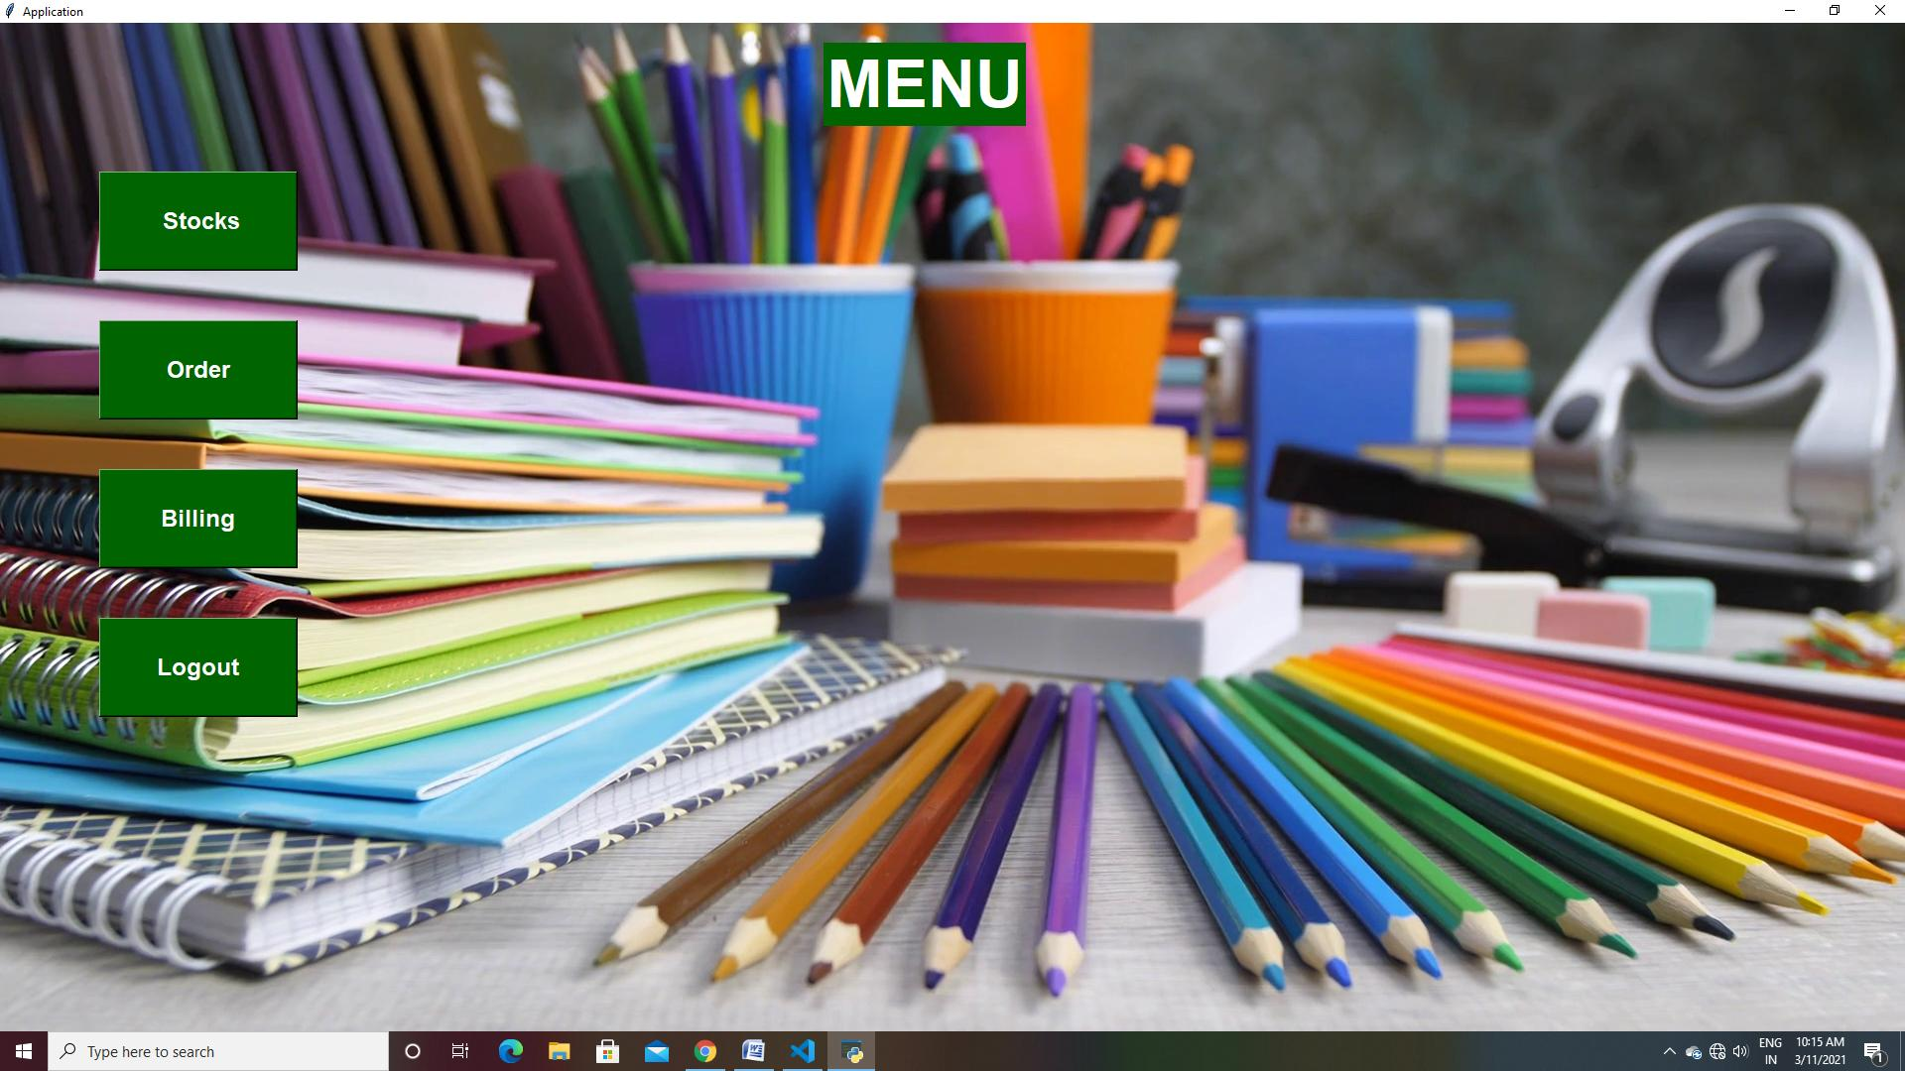

Slide 14
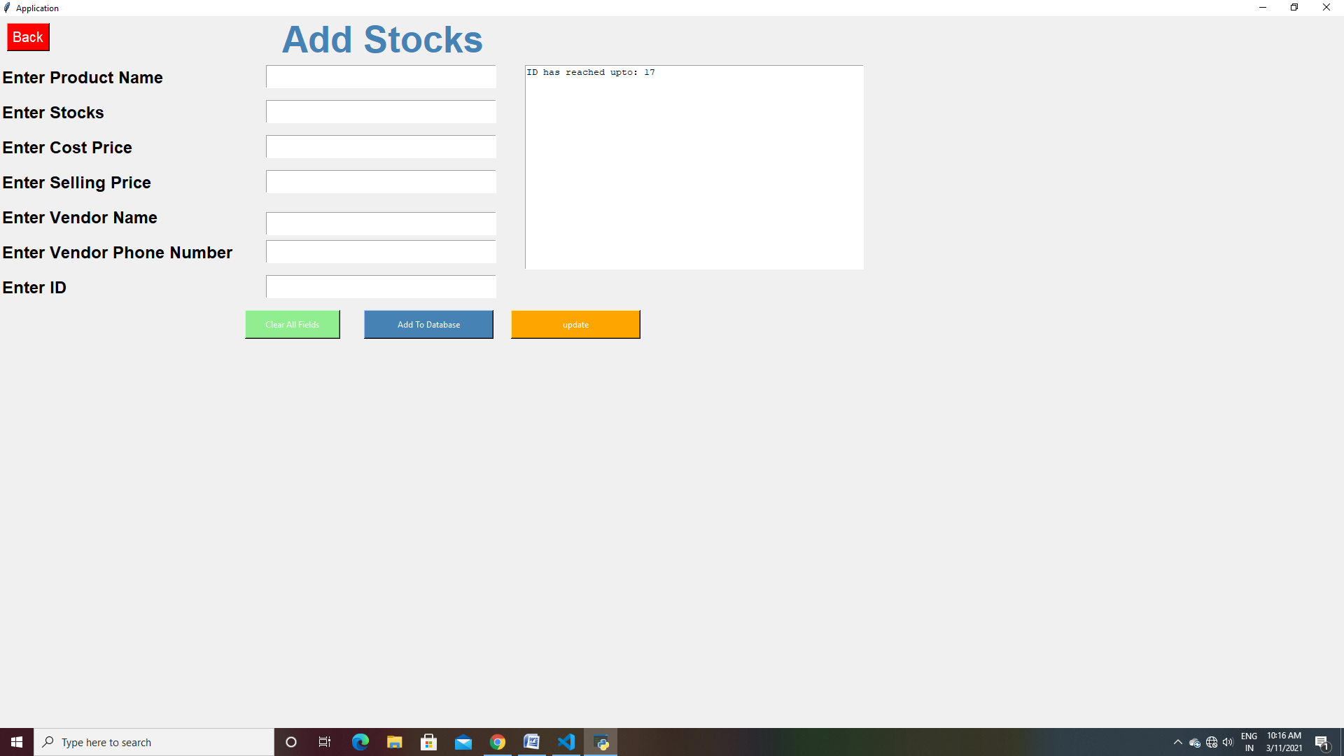

Slide 15
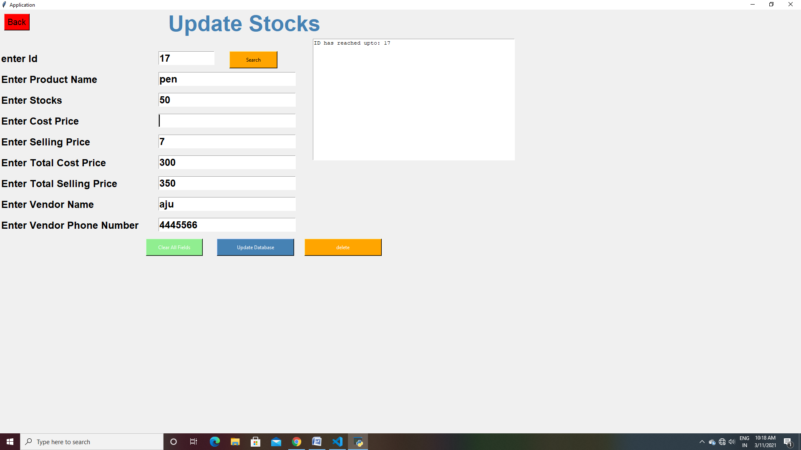

Slide 16
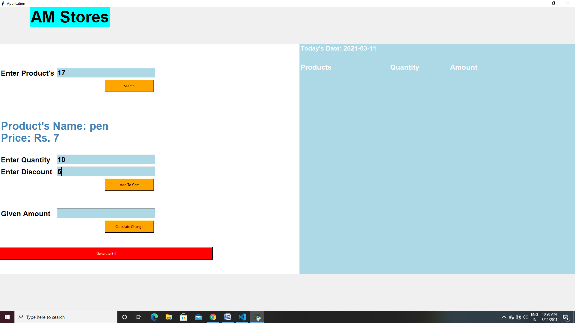

Slide 17
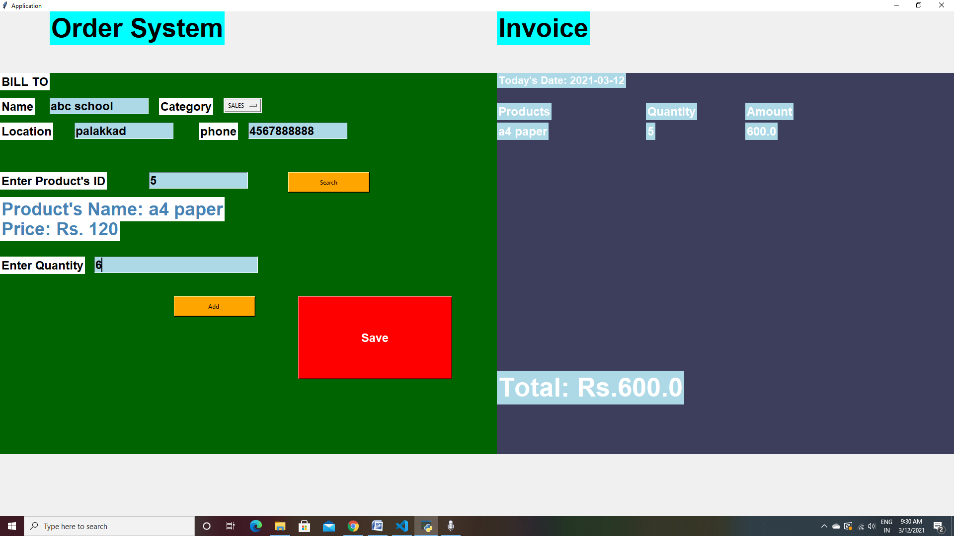

Slide 18
CONCLUSION
This research has designed a Computerized Stationary Management System to ascertain stock level of a stores, when to order for more products, keep status and updates of transactions, thereby helping managerial decisions, progress level and stock taking. But there is always a room for improvement in any software no matter how efficient the system may be. The important thing is that the system should be flexible enough for future modifications.

